Slide 1
Algebra 2 Inequalities
If ‘a’ is any real number then ‘a’ is either positive or negative or zero.
a > 0 or a < 0 or a = 0

Slide 2
Inequalities
For any two non-zero real numbers a and b
1. a > b when a – b > 0 and
2. a < b when a – b <0
Note:
If a < b then –a > -b and if a > b then –a < -b

Slide 3
Inequalities
If a = b then -a = -b But
If a < b then -a > -b and 2 < 3 but -2 > -3
If a > b then -a < -b 5 > 3 but -5 < -3
-→ By multiplying both sides of an inequality by a minus
the inequality sign gets Reversed
Less than becomes greater than and
Greater than becomes Less than.

Slide 4
Inequalities
Absolute value:
For any real number x , the absolute value is defined as follows:
| x | = { x if x ≥ 0 and -x if x < 0 }

Slide 5
Inequalities
In case of inequalities the variables generally take a range of values unlike in the case of equations where the variables in general take one value or a discrete set of values.

Slide 6
Inequalities
Linear Inequality:
Solve : 2x -3 < 5
2x -3 < 5
2x < 8 or x< 4 sol: ( -∞, 4)
This small bracket is called an open bracket meaning the end values are not included.

Slide 7
Inequalities
Solve: 3x + 5 ≥ 11
Sol: 3x + 5 ≥ 11
3x ≥ 6 x ≥ 2 solution : [2, +∞ )
The square bracket indicates the end value 2 is included.

Slide 8
exercise
A theatre company is auditioning for actors to portray the leading character in a new play. The company is looking for actors between the ages of 20 and 40 (inclusive). Which of the following inequalities can be used to determine whether an actor of age a is eligible to audition for the part?
A)| a-10 | ≤ 40 B)| a-20 | ≤ 40 C) a-30 | ≤ 20 D) | a-30 | ≤ 10 E) | a-35 | ≤ 5
The answer is 20 ≤ a ≤ 40. But how do we make that look like one of the inequalities above?
Take the average of 20 and 40. That’s 30.
Subtract 30 from everything to get 20 – 30 ≤ a – 30 ≤ 40 – 30
You get -10 ≤ a – 30 ≤ 10 Note that the left and right side of the inequality is the same number, except that the one on the left is negative
Now we can say, | a – 30 | ≤ 10
So the answer is clearly choice D.

Slide 9
Inequalities
Quadratic Inequality:
Solve : x² < 3x

Slide 10
Inequalities
Solve : x² < 36

Slide 11
Inequalities
Solve : x² - 4x - 5 < 0

Slide 12
Inequalities
Solve : x² > 5x

Slide 13
exercise
|4x + 14| > 30
What is a possible valid value of x?
A) 4 b) -11 c) 3 d) 1 e) 7

Slide 14
EXERCISE
Given the inequality, |2x – 2| > 20,
what is a possible value for x?
A) 0 B) 8 C) 11 D) -8 E) -10

Slide 16
Inequalities
Solve : x² > 25

Slide 17
Inequalities
Solve : x² - 3x - 10 > 0

Slide 18
Inequalities
For what values of x is x² < x ?

Slide 19
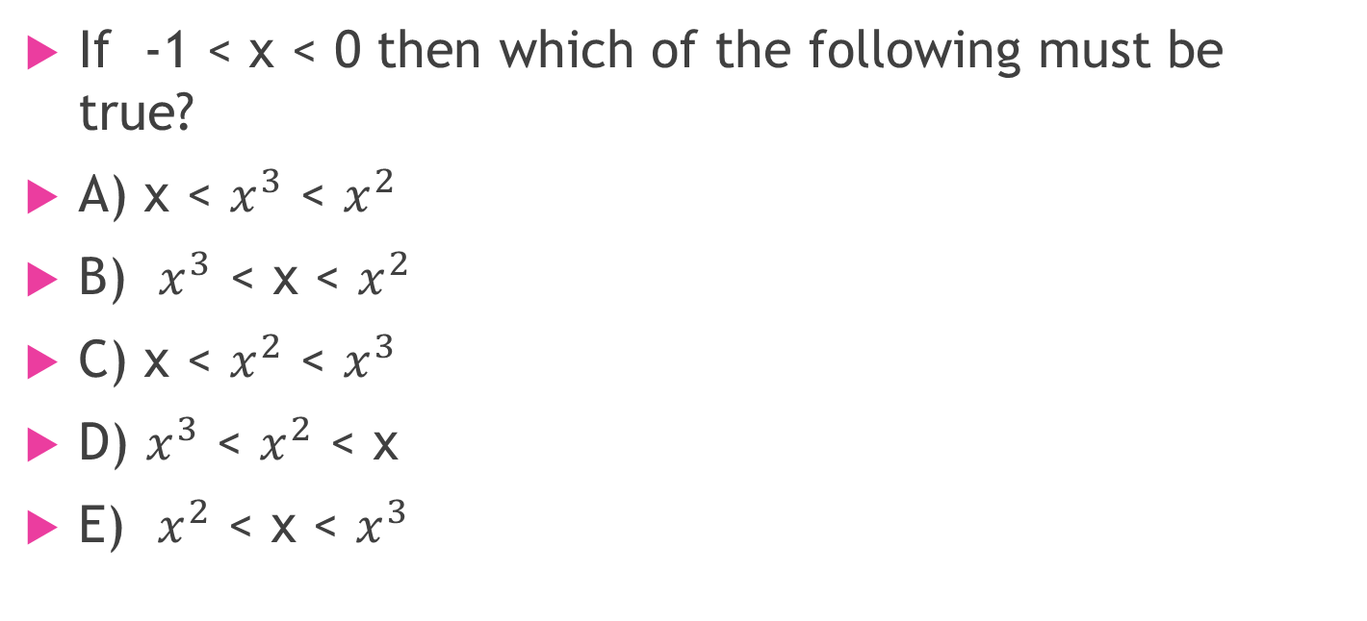
Inequalities
If -1 < x < 0 then which of the following must be true?
A) x < $x^{3}$ < $x^{2}$
B) $x^{3}$ < x < $x^{2}$
C) x < $x^{2}$ < $x^{3}$
D) $x^{3}$ < $x^{2}$ < x
E) $x^{2}$ < x < $x^{3}$

Slide 20
Mod Functions
The modulus of a given number describes the magnitude of the number
|x| = { x if x ≥ 0 and
{ -x if x < 0
Rule:
If |x| = a then x = a if x > 0 and x = -a if x < 0
If |x| < a then x < a if x > 0 and x > -a if x < 0
If |x| > a then x > a if x > 0 and x < -a if x < 0

Slide 24
Inequalities
If |x² – 5x + 6| + |x² – 8x + 12| = 0. Find x

Slide 25

Inequalities
$3\left(x−7\right)≥9$ and $0.25y−3 ≤1$
Column A Column B
X y

Slide 26

Inequalities
If $2(x−{1)}^{3}+3 ≤19,$then x = ?

Slide 27

inequalities
If $\left|0.1x−3 \right| ≥1,$then x could be which of the following values? Indicate all such values?
A) 10 B) 20 C) 30 D) 40 E) 50 F) 60

Slide 28

Inequalities
If $\left|y\right|≤ −4x$ and $\left|3x−4\right|=2x+6$ then what is the value of x?

Slide 29

Inequalities
Which is greater ?
$p+ \left|k\right|> \left|p\right|+k$
Column A Column B
P k

Slide 30

Inequalities
Which is greater ?
$\left|x\right|y>x\left|y\right|$
Column A Column B
x y

Slide 31

Inequalities
For all integer values of p such that $1.9< \left|p\right|<5.3$, the function f(p) = p²
Column A Column B
f( p) for the greatest value of p f(p) for the least value of p

Slide 32

inequalities
If $4<x<10$ and 5 < y < 6 then find ( x – y)

Slide 33
Inequalities
Solve :−2 < 6−2x < 4
3

Slide 34
Inequalities
Solve : -9 < 5 - 7y ≤ 12

Slide 35
Inequalities
Solve the inequality -4 ≤ 3x + 2 < 5

